Slide 1
Raytracing
Rutger van den Berg - 4060156
Ymte Jan Broekhuizen – 4246586
Qu Chen – 1256025
Arend Jan de Graaff – 4012534
Max Groeneboom – 4169298
Rick van Hattem - 1297295
Ewoud van der Heide – 1534033
Leon Hoek – 4021606
Vince Kasanpawiro - 4028880

Slide 2
COMPETITION IMAGE TBD
COMPETITION IMAGE TBD

Slide 3
WORK DISTRIBUTION
Rutger: Debugging Linux, reflection, made sphere model
Ymte Jan: Octree, multithreading, old RealTime RayTracing, shadows, added movement of model through WASDEQ keys, added ground textures, Phong shaders
Qu: Debugging Visual Studio, Ray-Sphere Intersection, made slides
Arend Jan: Debugging Visual Studio, made a branch, updated slides
Max: Ray-Sphere Intersection, Ray-Triangle Intersection, debugging Visual Studio, made Sierpinski Pyramid model, made UglyThing model, made cube model, shadows, old FPS counter
Rick: Multithreading, downloaded simplemonkey model, debugging McOS, hosted git, timer, rewriting galore, background raytracing, , current FPS counter, current RealTime RayTracing
Ewoud: Colours, made beer bottle model
Leon: Octree, debugging Linux, made football model
Vince: Made Diamond model, made slides, debugging Visual Studio

Slide 4
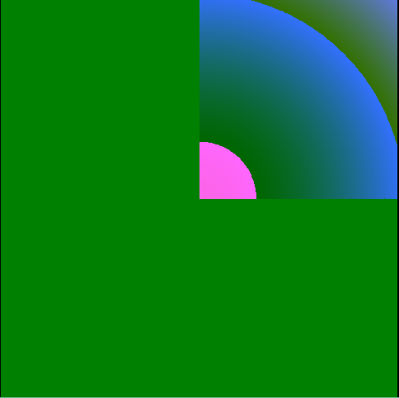
Psychedelic Art

Slide 5
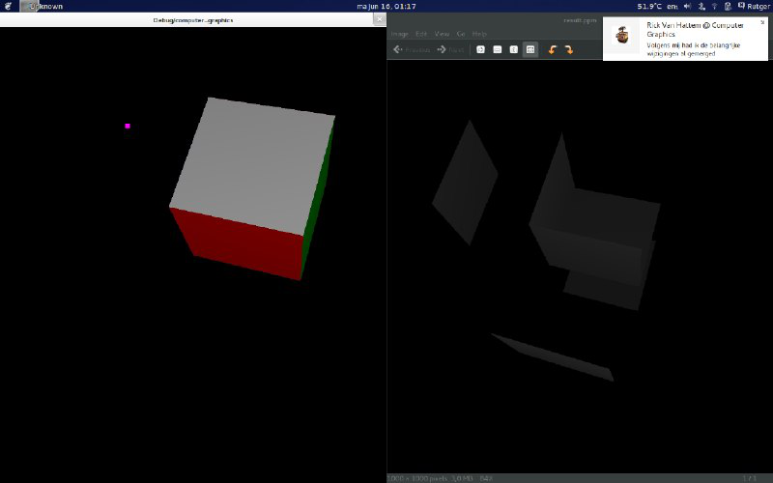
Our previous iterations

Slide 6
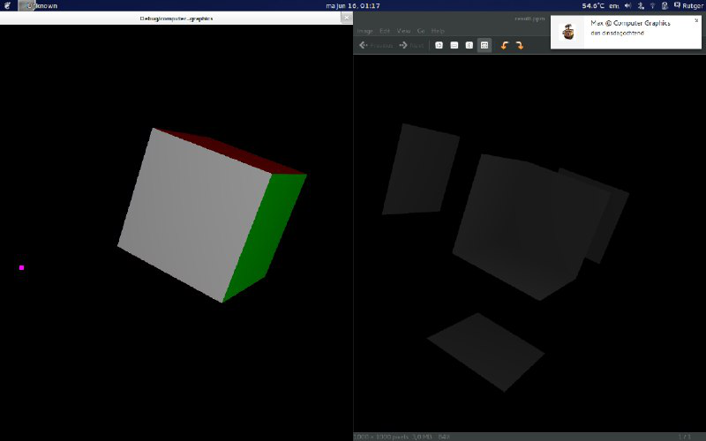

Slide 7
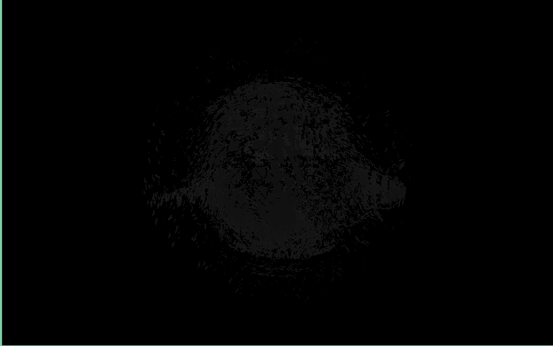
Monkey, not there yet.

Slide 8
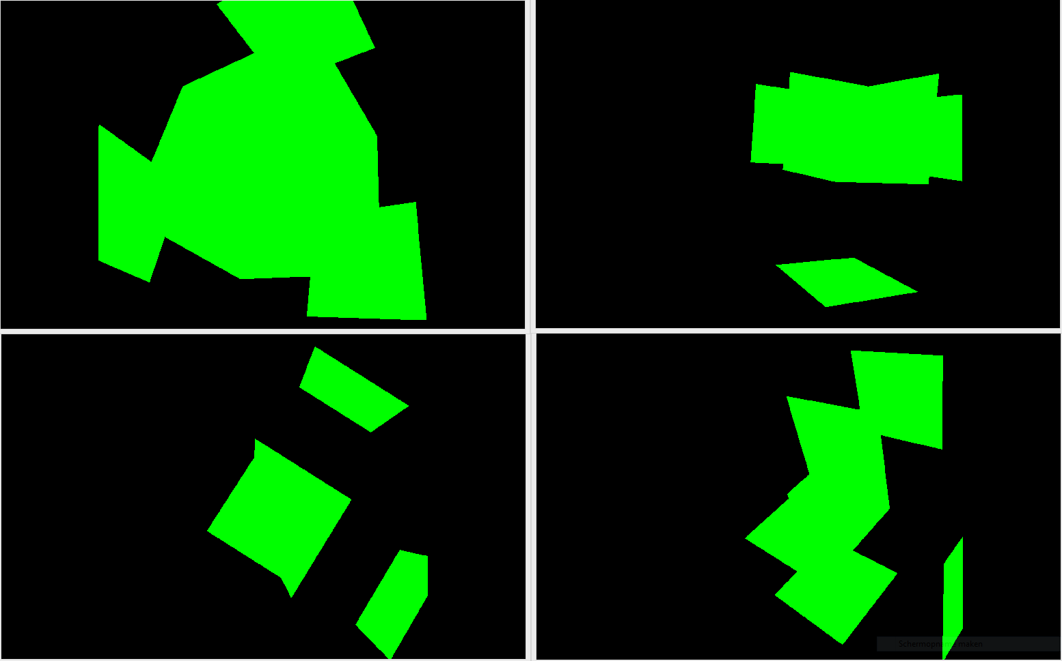
A slight problem with Cube

Slide 9
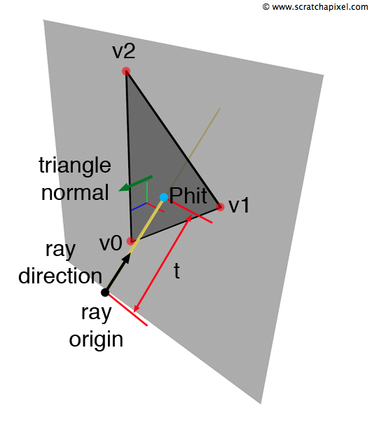
Geometric raytracing not working…

Slide 10
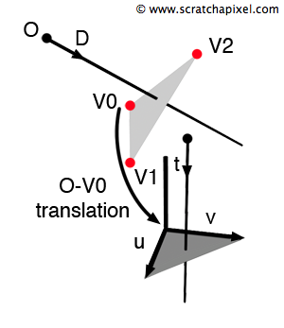
Solution: Use Möller-Trumbore fast intersection method

Slide 11
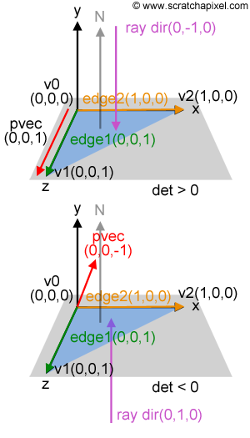
Solution: Use Möller-Trumbore fast intersection method

Slide 12
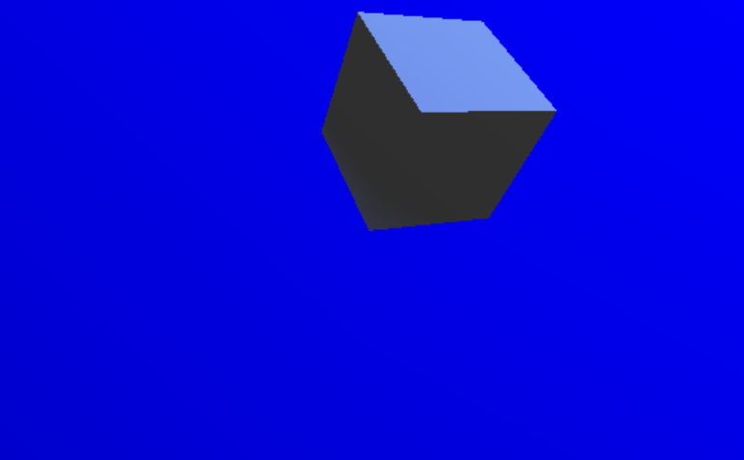
Raytracing intersection working

Slide 13
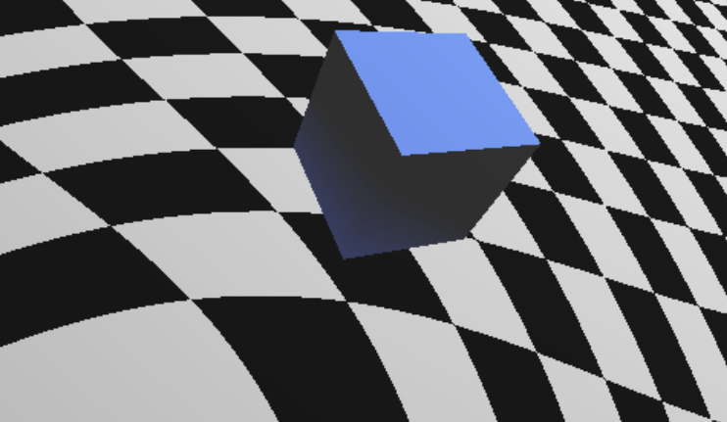
Add Background…

Slide 14
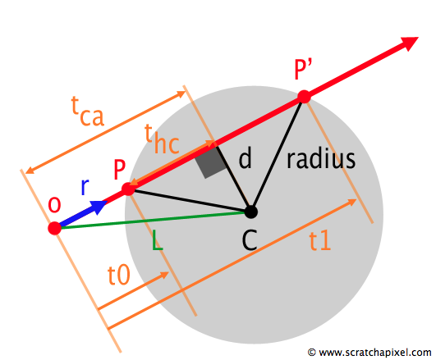
Tried Sphere intersection

Slide 15
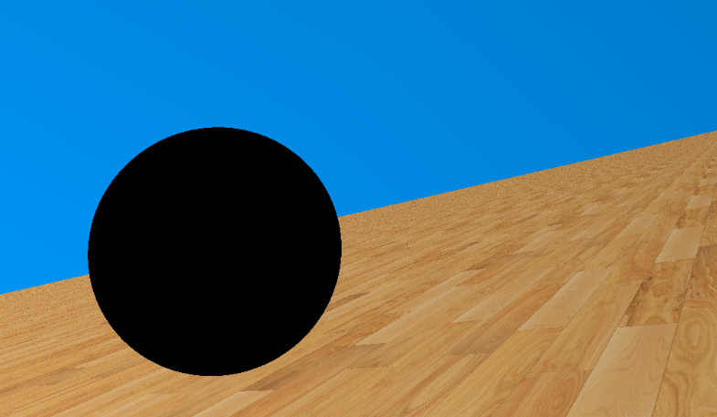
Not very interesting…

Slide 16
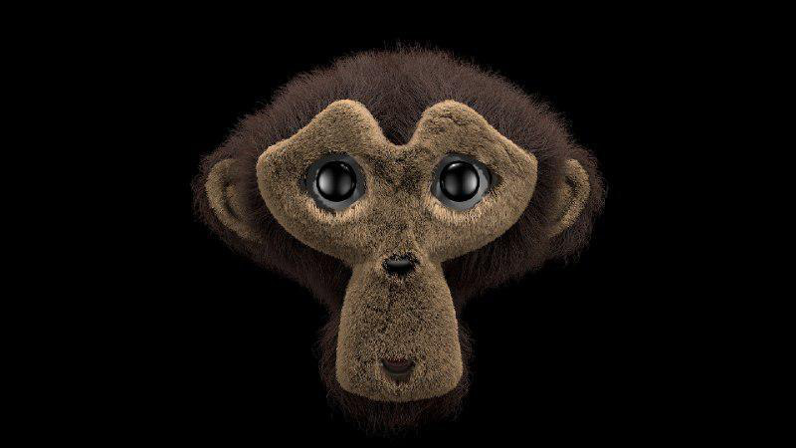
New Mesh SimpleMonkey

Slide 17
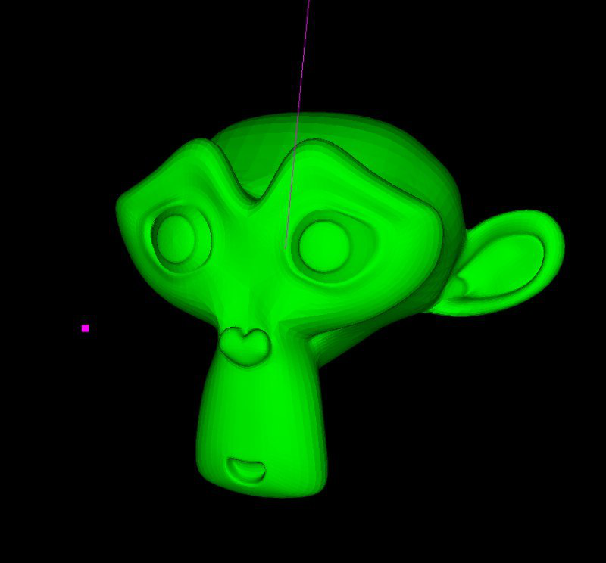
New Mesh SimpleMonkey

Slide 18
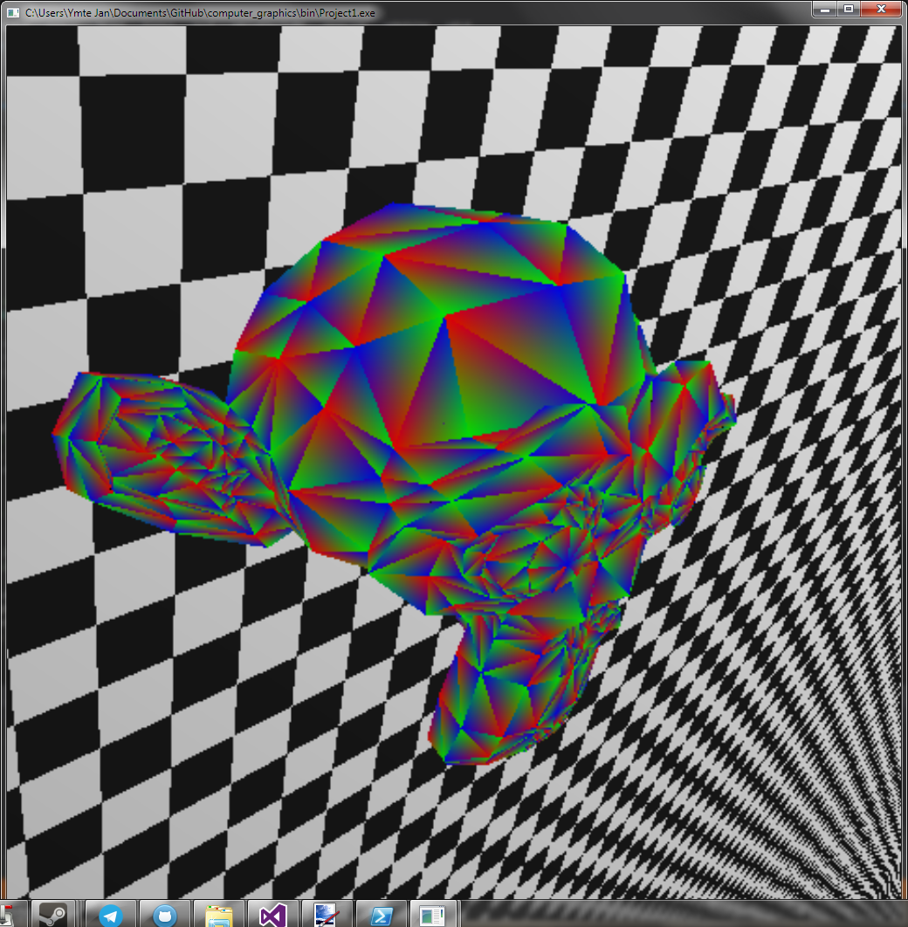
Trying to implement Blinn-Phong: using the normals as colors for the mesh

Slide 19
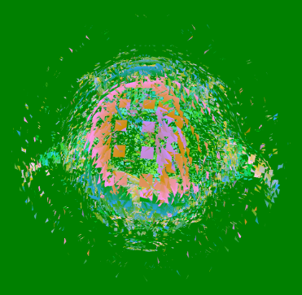
More psychedelic Art

Slide 20
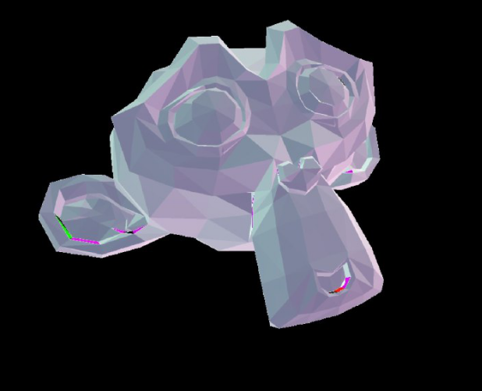
More psychedelic Art

Slide 21
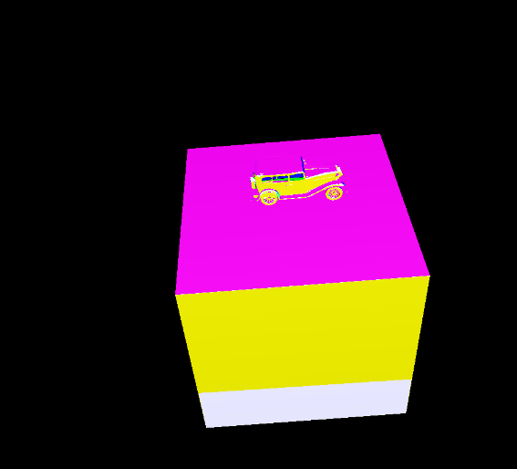
More psychedelic Art

Slide 22
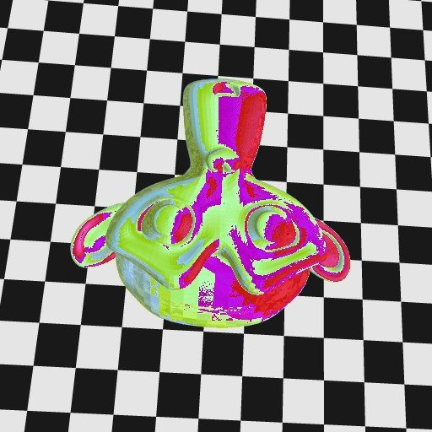
More psychedelic Art

Slide 23
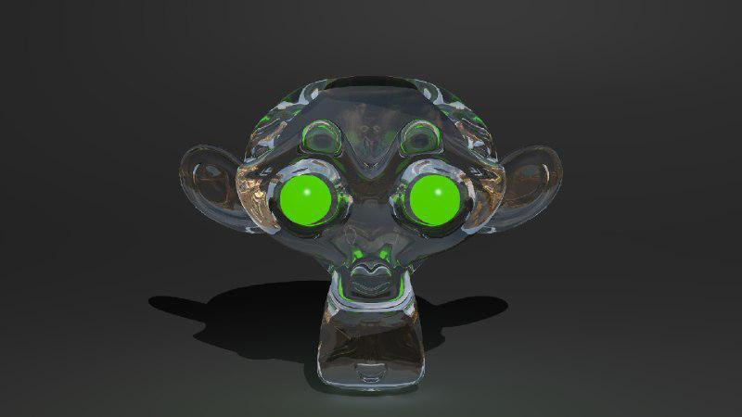
More psychedelic Art

Slide 24
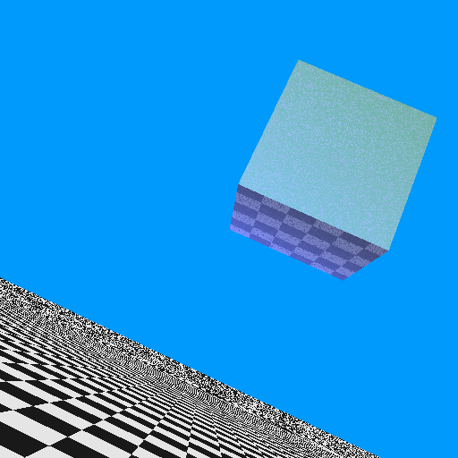
Reflection!

Slide 25
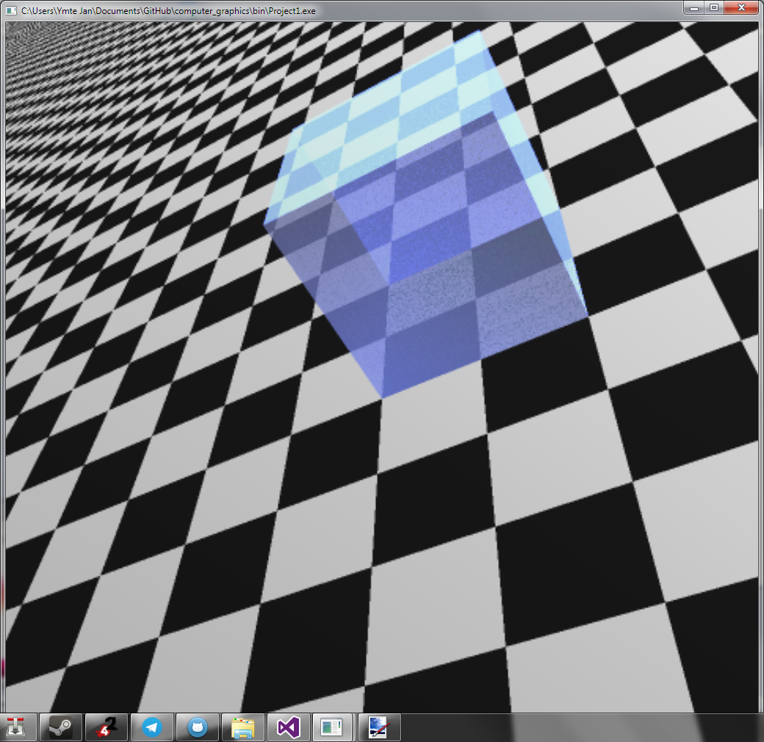
Translucency

Slide 26
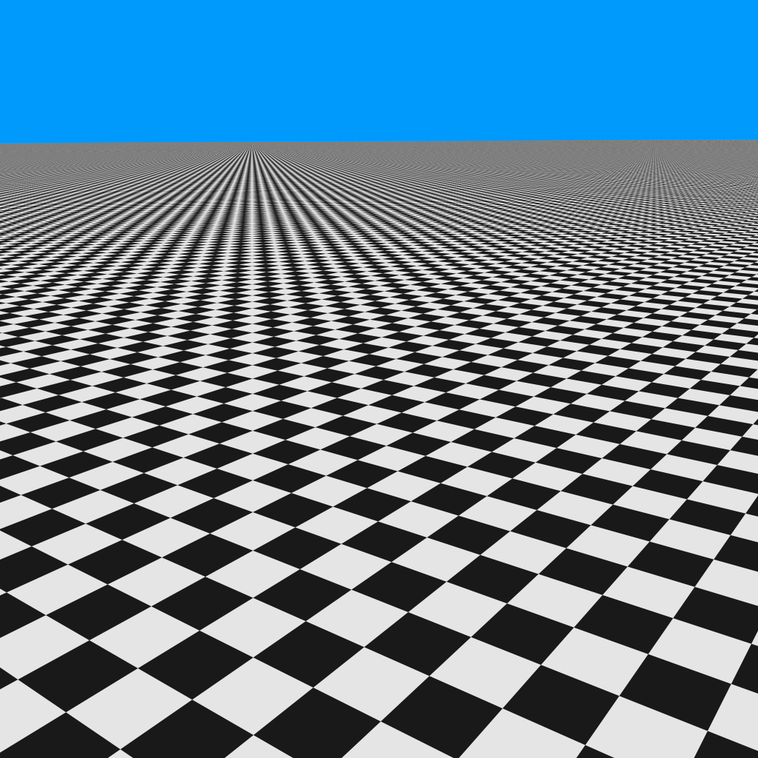
Supersampling

Slide 27
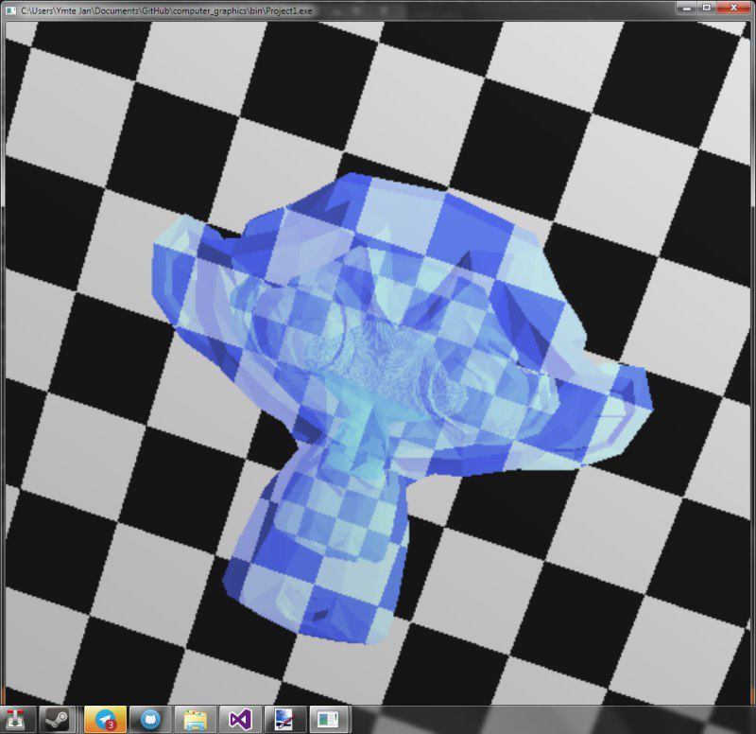
Refraction???

Slide 28
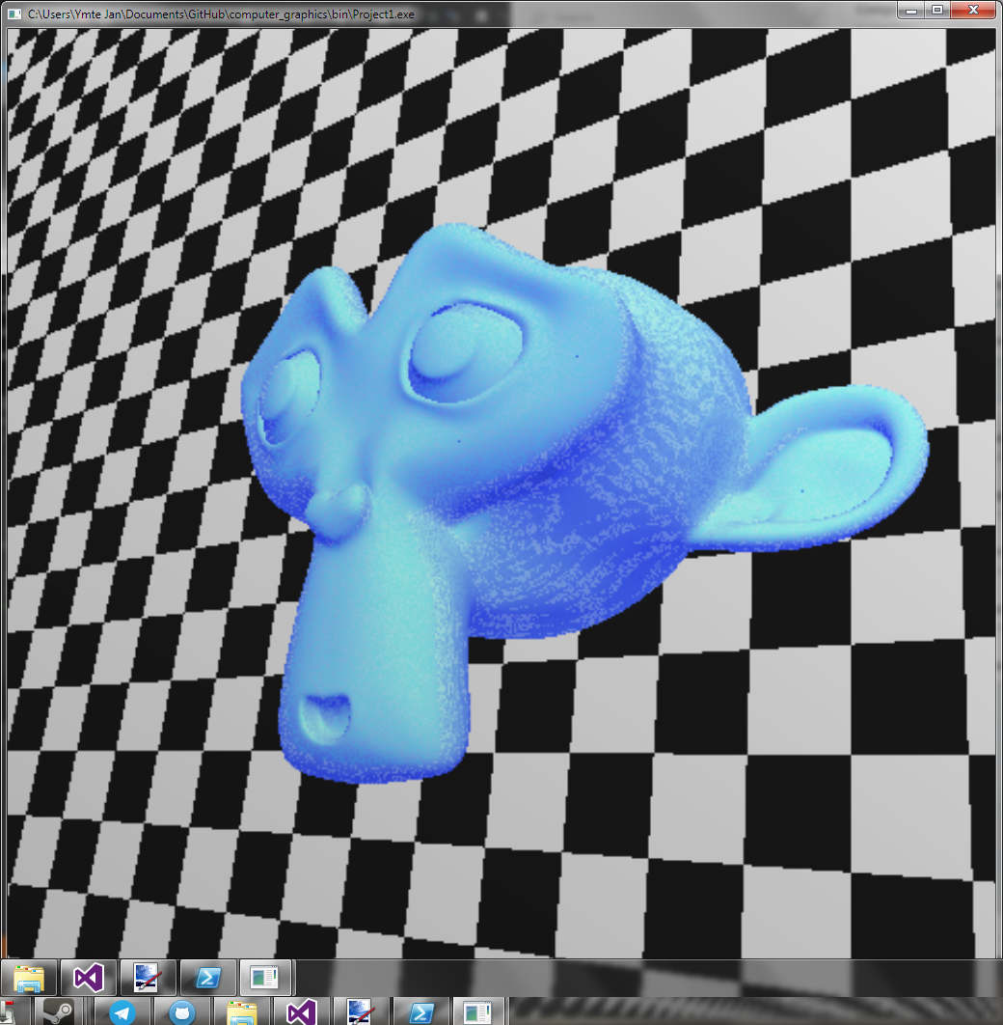
Colors not matching

Slide 29
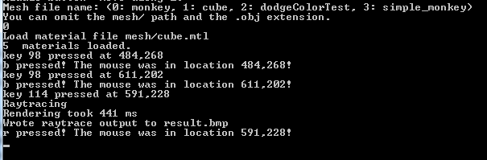
Slow

Slide 30
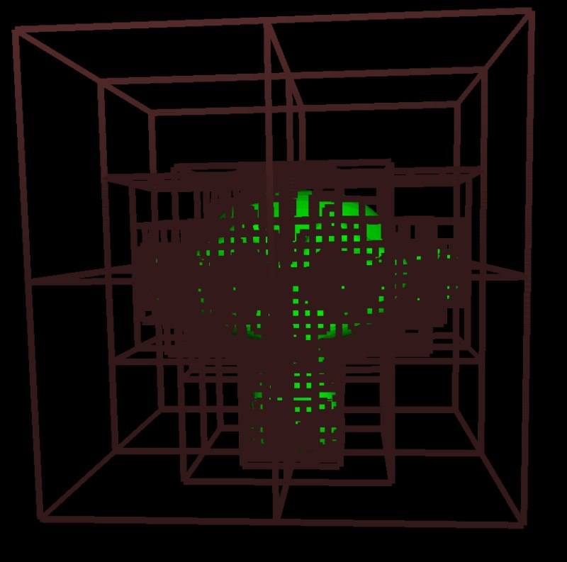
Octrees

Slide 31
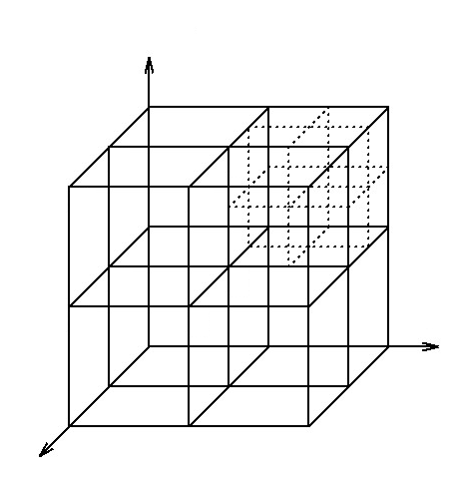
Octrees

Slide 32
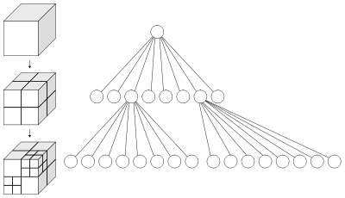
Octrees

Slide 33
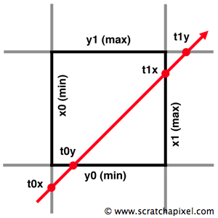
Octrees

Slide 34
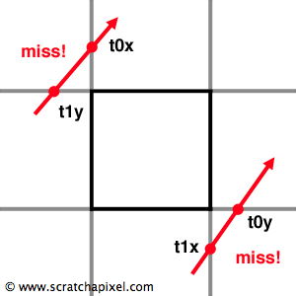
Octrees

Slide 35
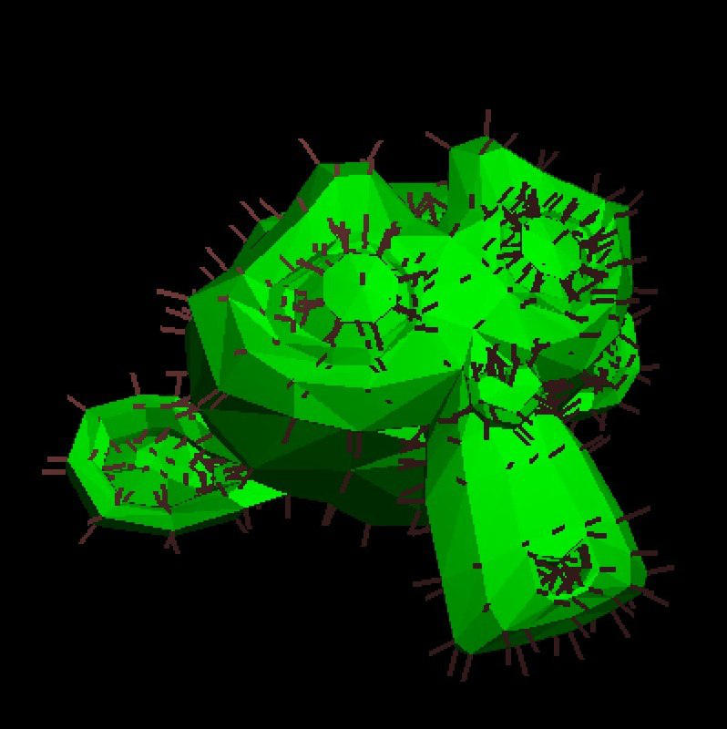
Octrees

Slide 36
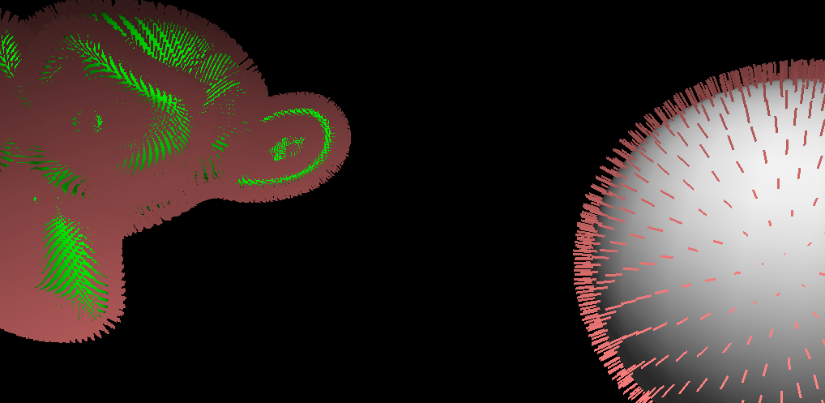
Octrees

Slide 37
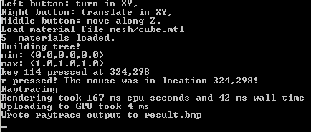
Octrees

Slide 38
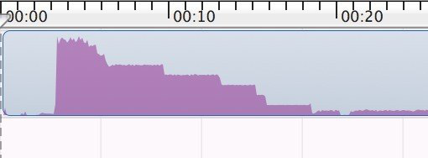
Still Slow - Need to use Multithreading

Slide 39
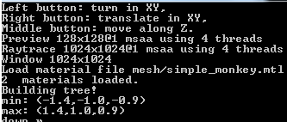
Multithreading

Slide 40
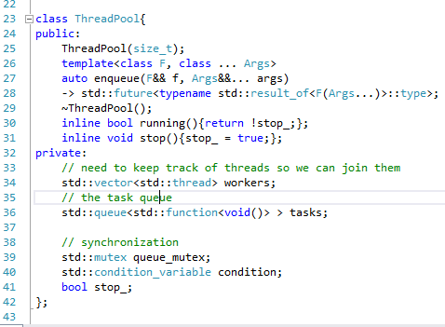
Multithreading

Slide 41
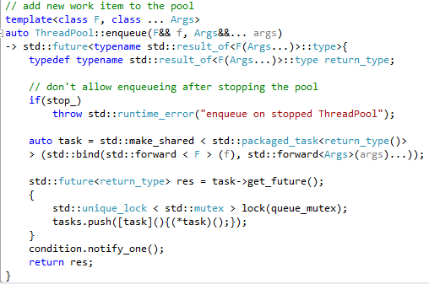
Multithreading is sometimes difficult…

Slide 42
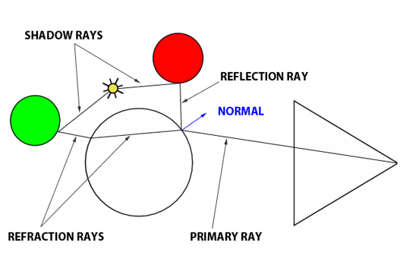
Reflection, Refraction and shadows

Slide 43
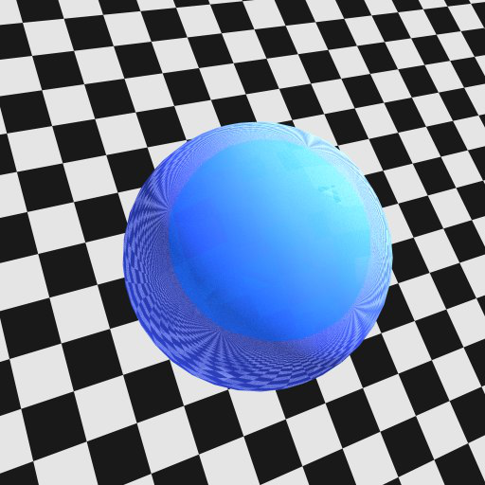
Reflection

Slide 44
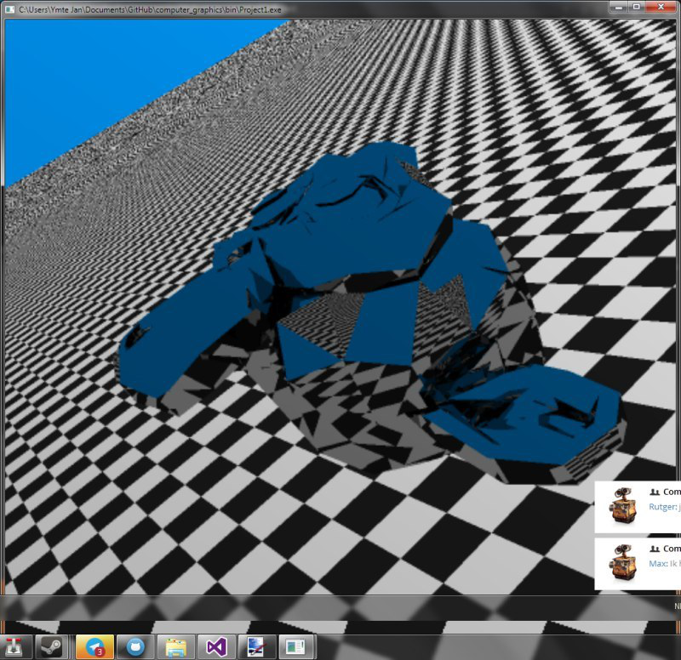
Reflection

Slide 45
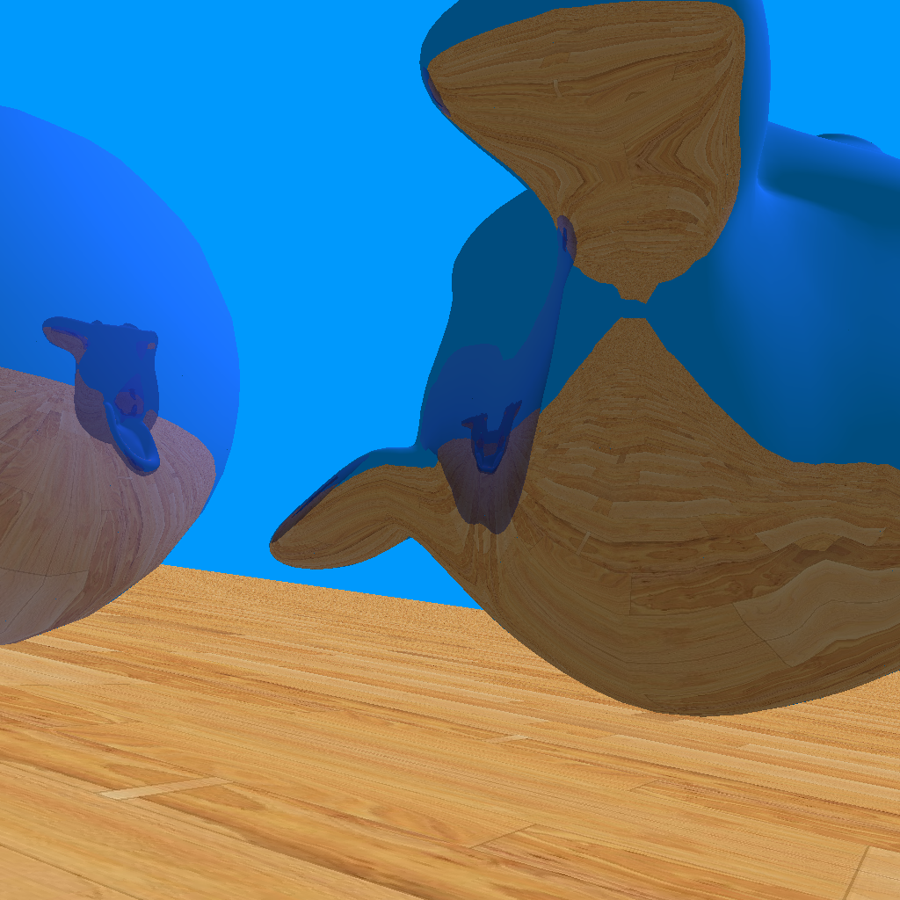
Reflection into other objects

Slide 46
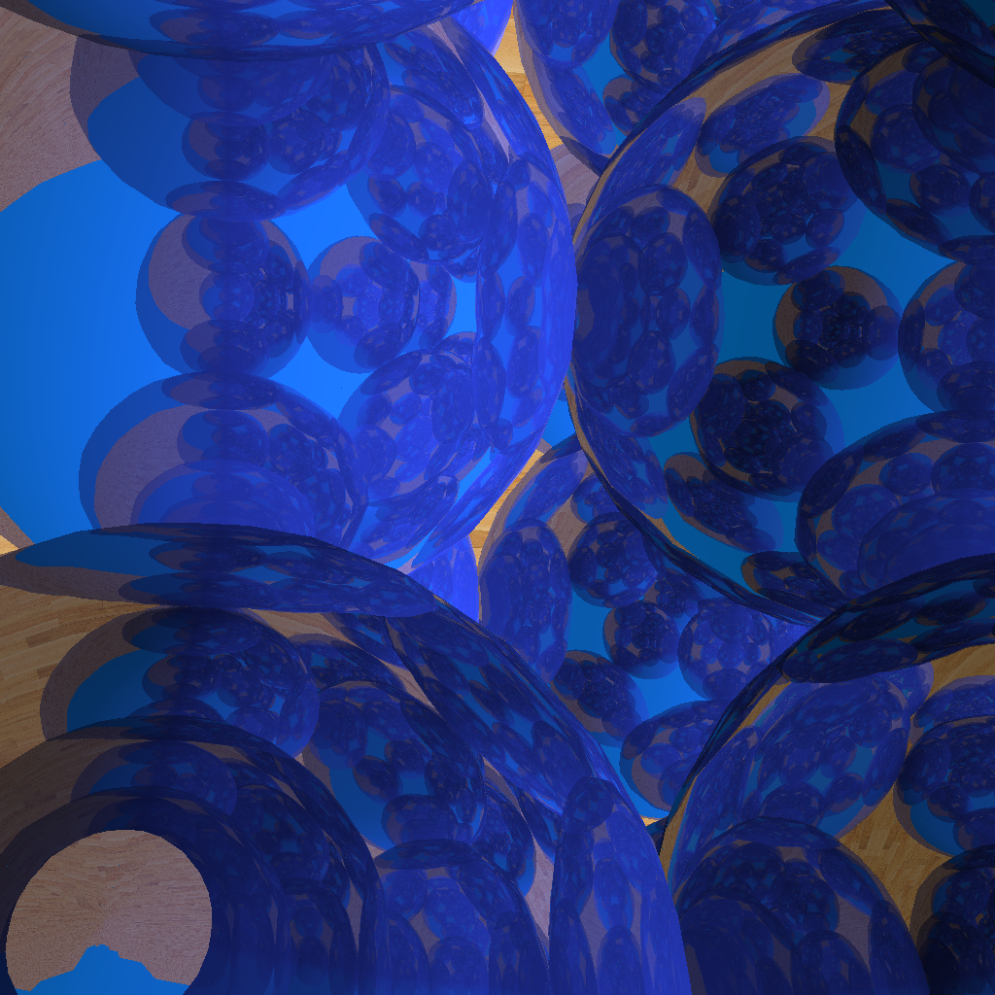
Reflection into other objects

Slide 47
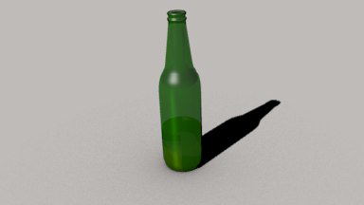
Beermodel

Slide 48
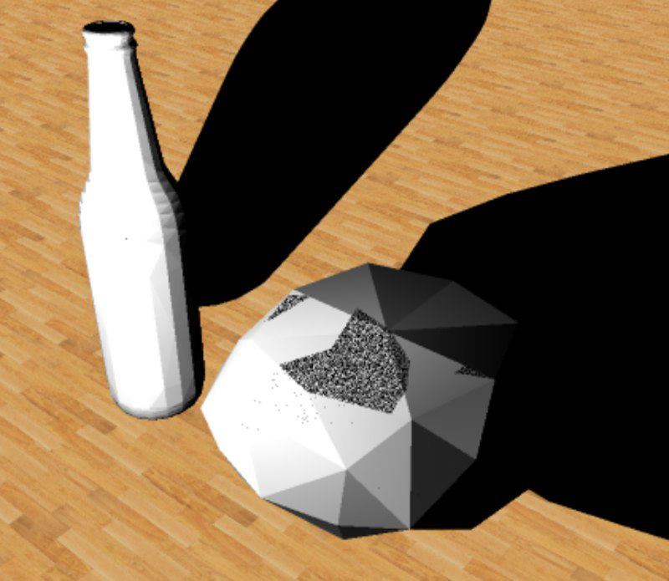
Shadows

Slide 49
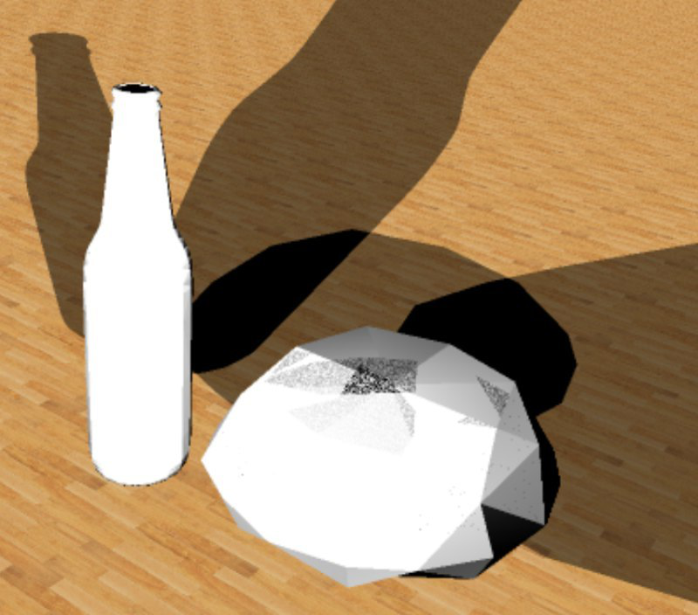
Multiple Light Sources

Slide 50
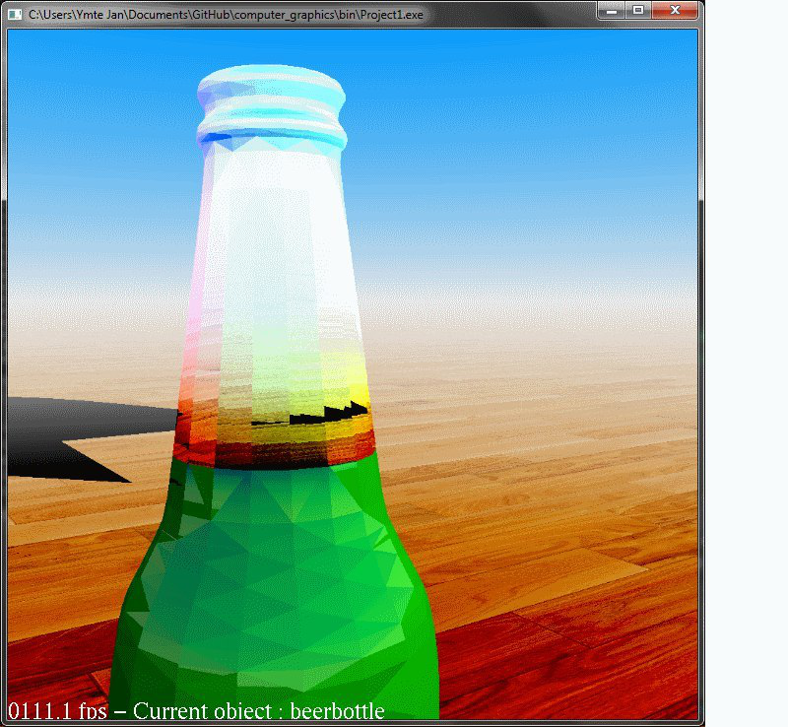
Refraction

Slide 51
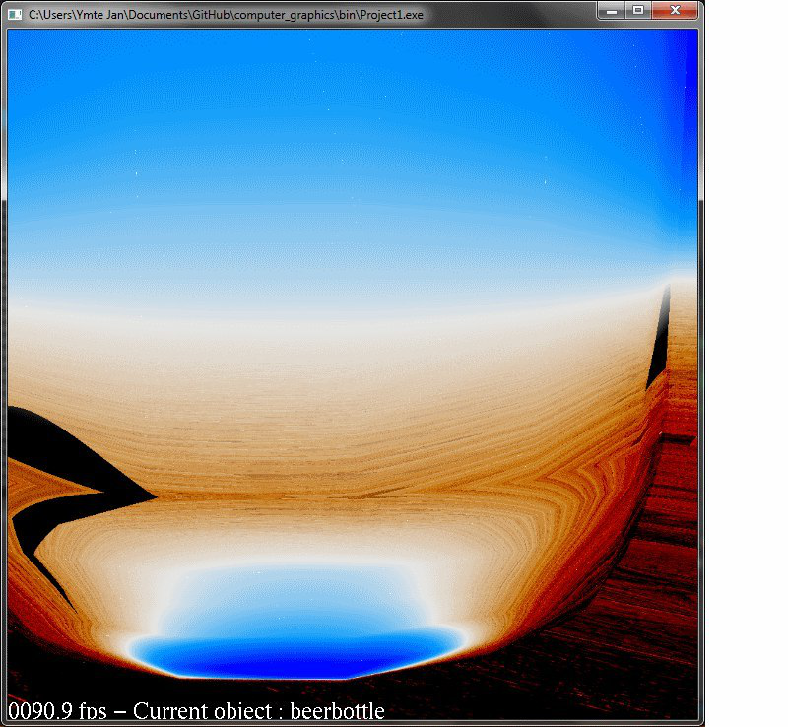
Refraction

Slide 52
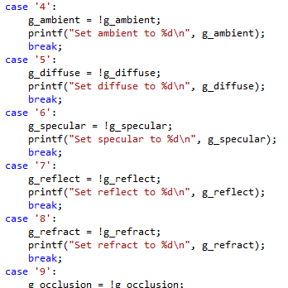
Adding Toggles

Slide 53
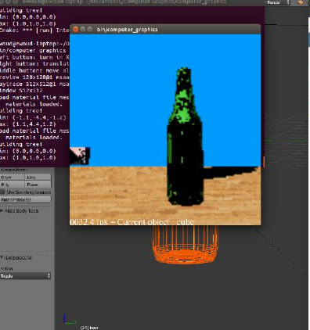
Live Raytracing

Slide 54

FPS Counter

Slide 55
Demo

Slide 56
Finalizing the result

